Slide 1

Data First Culture
Post-Digital Transformation and Intellectual Debt
Neil D. Lawrence

Slide 2
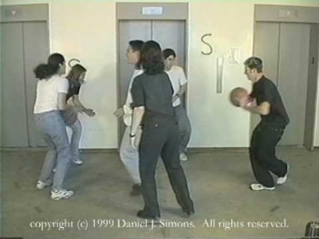

Slide 3
I am a data science:
follower (no visibility/influence)
some visibilty/influence
visibility and some influence
leader (lead on data and AI developments)

Slide 4
BMI Steps Analysis

Slide 6
“ ‘When someone seeks,’ said Siddhartha, ‘then it easily happens that his eyes see only the thing that he seeks, and he is able to find nothing, to take in nothing. […] Seeking means: having a goal. But finding means: being free, being open, having no goal.’ ”
Hermann Hesse

Slide 7
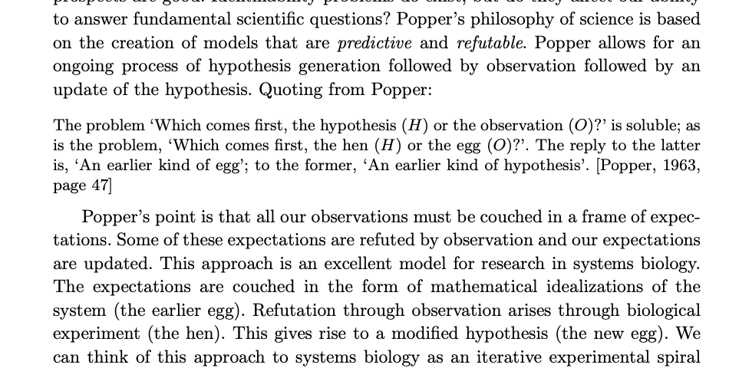

Slide 8
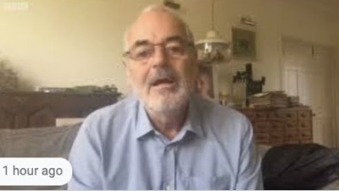

Slide 9
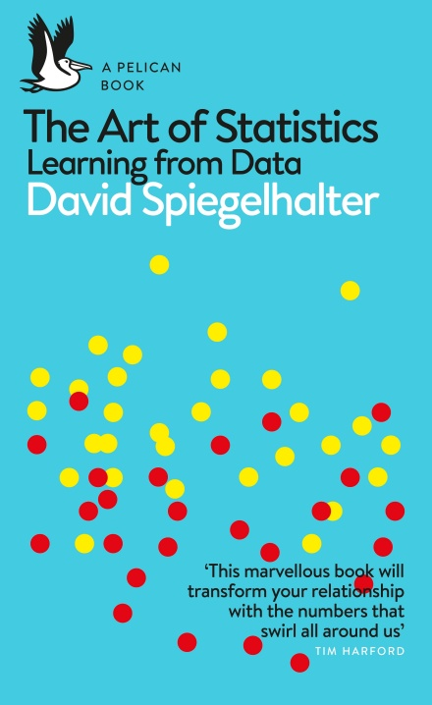
The Art of Statistics
David Spiegelhalter

Slide 10
Notes:
Bogeyman, Fred Garage. Henry Ford, More Intelligent Human

Slide 11


Slide 12
E S A R I N T U L
O M D P C F B V
H G J Q Z Y X K W

Slide 13
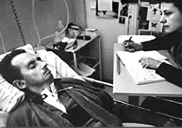
bits/minute
6
2000
billions
a billion
billion
a billion
billion
calculations/s
trillions
5 trillion
years
15 billion
years
20
minutes
embodiment

Slide 15
?
!#@%&?
#
!
&
!
£*?$&!
&
?
#

Slide 16

For Sale, Baby Shoes, Never Worn

Slide 17
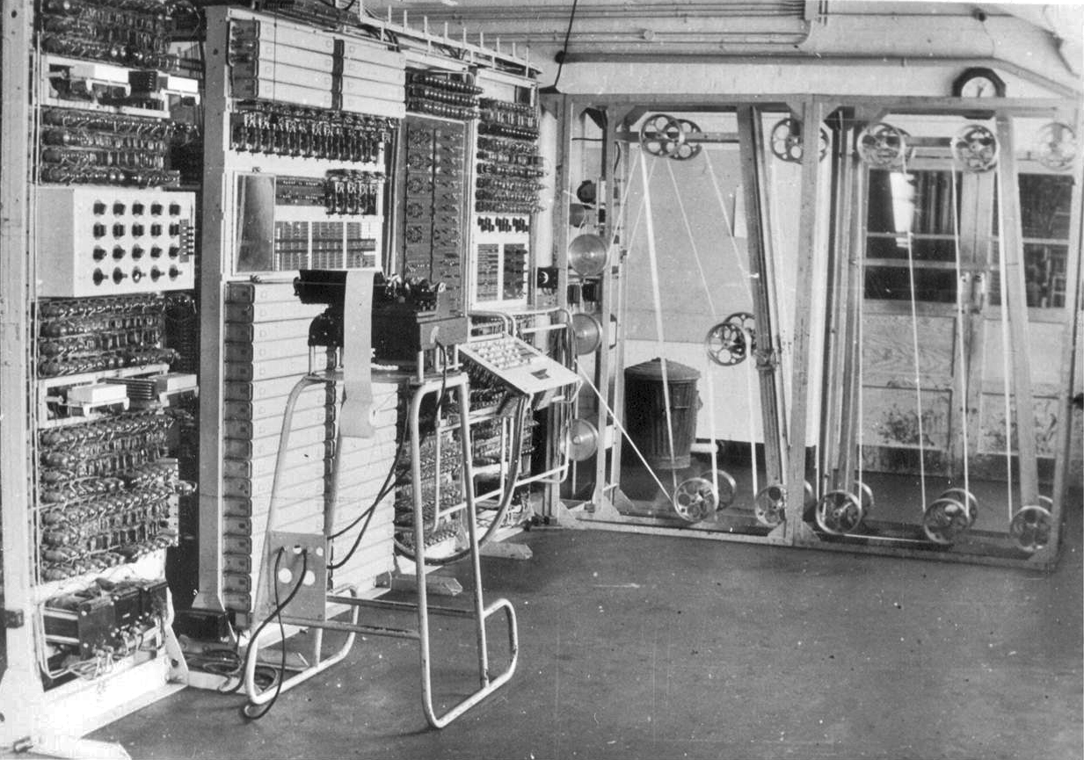

Slide 18
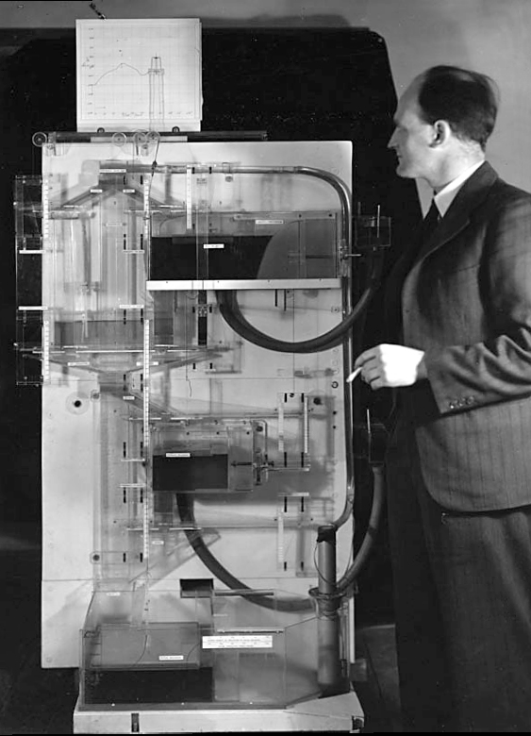
Notes:
Bill Phillips standing next to the MONIAC

Slide 19
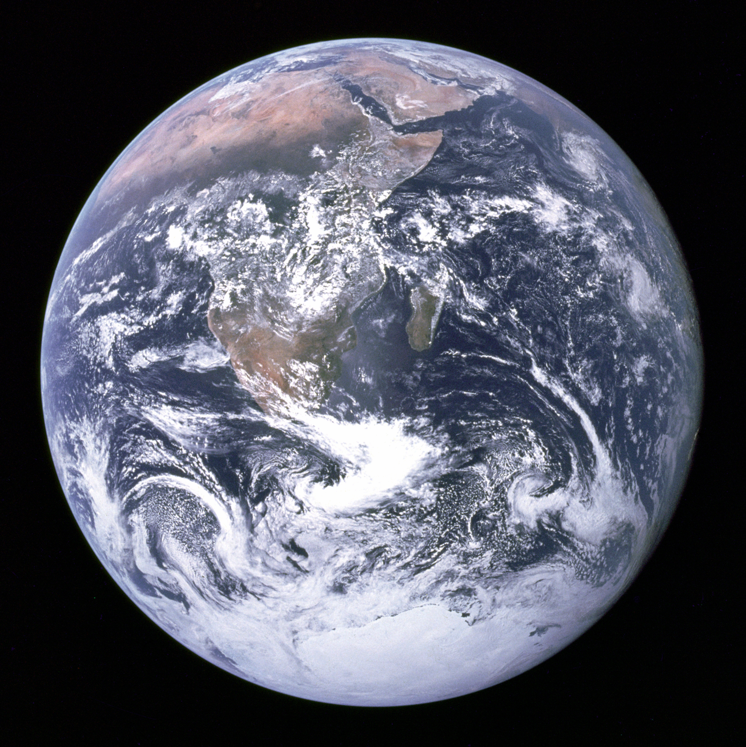

Slide 20
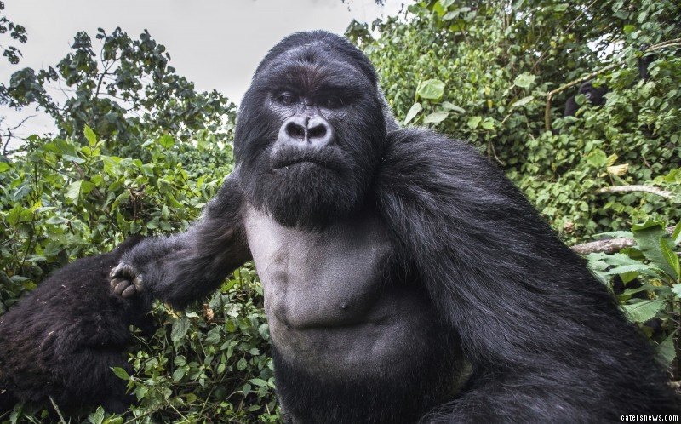
See the Gorilla don’t be the Gorilla.

Slide 21
twitter: @lawrennd
podcast: The Talking Machines
newspaper: Guardian Profile Page
blog posts:
Open Data Science
System Zero

